Slide 1
Regenstrief Reloaded: The Regenstrief Medical Record System

Slide 2

Welcome & Introductions

Slide 3
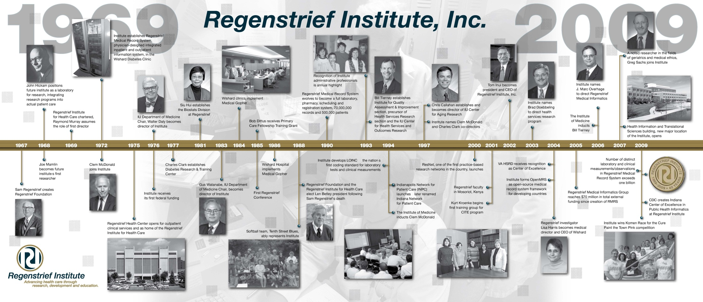

66 | 68 | 70 | 72 | 74 | 76 | 78 | 80 | 82 | 84 | 86 | 88 | 90 | 92 | 94 | 96 | 98 | 00 | 02 | 04 | 06 | 08 | 10
DOCS4DOCs
RMRS
Gopher
INPC
SPIN
1972
1984
1992
2002
2004

Slide 4
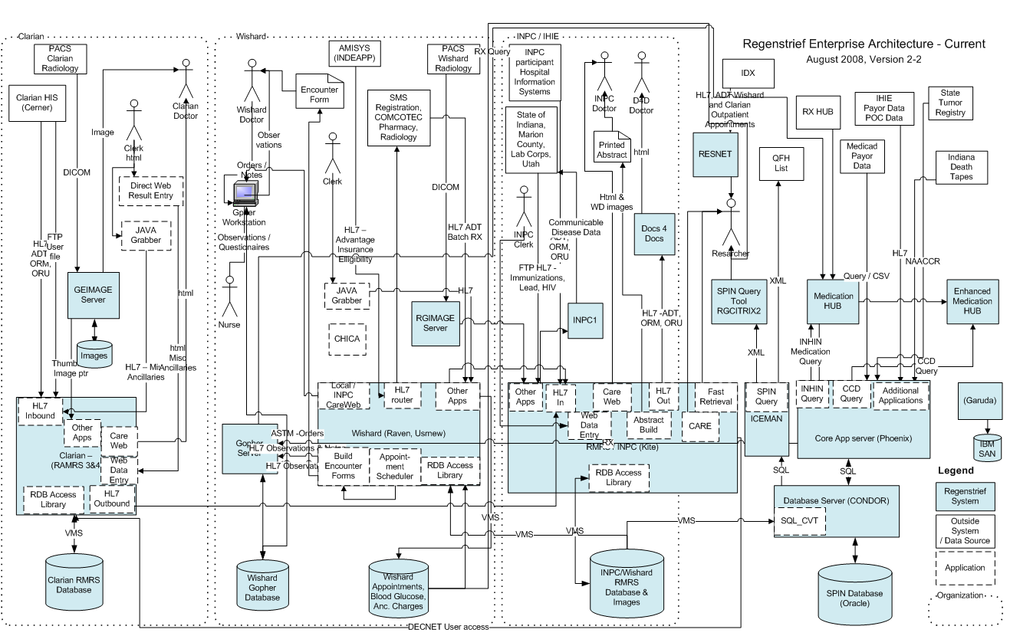
Current System Dataflows

Slide 5
Rationale for Re-engineering
Software platform reaching end of life
Systems reaching limits of extensibility
Difficulty recruiting engineers with relevant experience
Diminishing compatibility with evolving infrastructure
Limited ability to leverage contemporary tools
Complexity of maintaining multiple systems
Notes:
Say something about re-engineering ➔ preserve functions

Slide 6
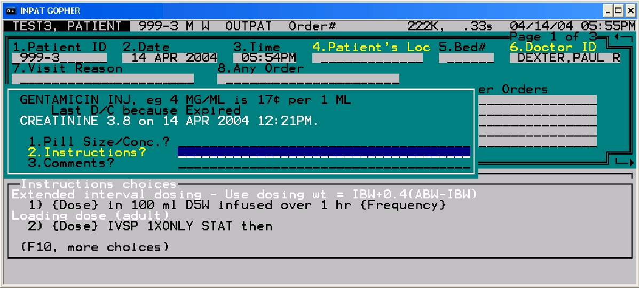

Slide 7
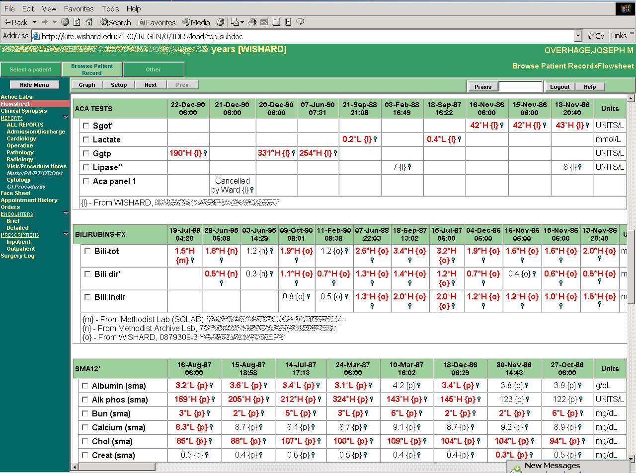
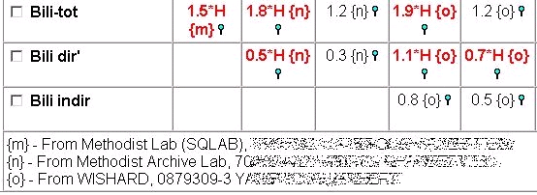

Slide 8
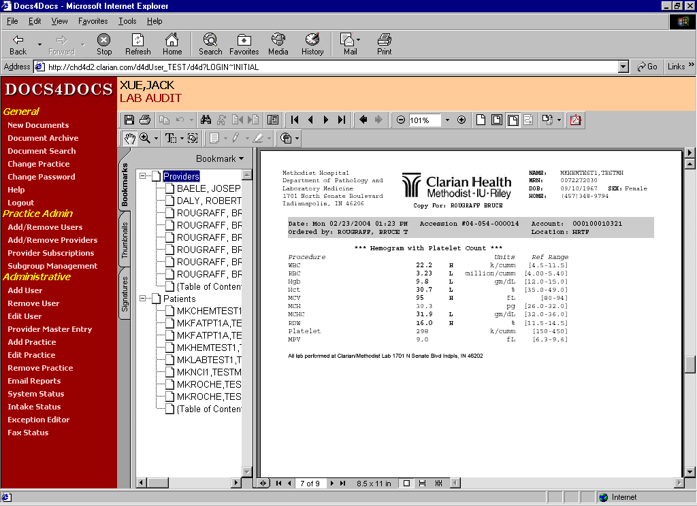

Slide 9
Rationale for Re-engineering
Software platform reaching end of life
Systems reaching limits of extensibility
Difficulty recruiting engineers with relevant experience
Diminishing compatibility with evolving infrastructure
Limited ability to leverage contemporary tools
Complexity of maintaining multiple systems

Slide 10
Goals of New Platform
Web-based
Built on open source technologies
Modular design
Emphasis on component re-use
Extensible architecture
Ease of development
Minimal configuration
Support our research mission!

Slide 11
Key Technologies
Spring Framework
Spring Security
ZK Framework
JQuery
Oracle Help for Java
Apache ActiveMQ Server
Apache Web Server
Apache Tomcat
Oracle / PostgreSQL

Slide 12
Architecture
User
Interface
Flowsheet
Order
Entry
User Preferences
Web
Resources
SMArt
Plug-in
Plug-in
Widgets
Electronic
Signature
Patient
Selection
User
Authentication
Plug-in
Services
Layout
Manager
Layout
Designer
Framework
Services
Internal
Services
Electronic
Signature
Patient
Context
User
Context
Plug-in
Services
Context
Management
Event
Management
Component
Registration
Help
Subsystem
Theme
Support
Framework
Services
External
Services
Data
Access
Security
Services
Messaging
Services
Web
Services
Core
Services

Slide 13
Plug-in Inventory
Results display
Recent results
Flowsheet
Clinical abstract
Clinical documents
Encounter display
Order summary
Data capture
Results entry
Order entry
Quick notes
Document uploader
Electronic signature
Problem list management
User tools
User preferences
User feedback
Notifications
Administrative
User management
Remote troubleshooting
Property management
Administrative reports
Research
Medication reconciliation
Med profile visualization
SMArt plug-ins
Notes:
Switch to demo – show plugins, help content, about box, design mode.

Slide 14
SMArt: No Small Change*
SMArt (Substitutable Medical Applications, reusable technology) is part of ONC’s SHARP initiative to promote “breakthrough” technologies.
Enables CareWeb and other EMR platforms (e.g., Cerner, VistA, etc.) to run interchangeable applications that will be available through an open app exchange (coming in 2011)
US CTO Aneesh Chopra has announced the SMArt Health App $5000 Challenge
See http://www.smartplatforms.org
* Mandl and Kohane, NEJM 2009; 360:1278-1281
Notes:
Ken and Zak’s Perspective piece in 2009, “No Small Change for the Health Information Economy” described an iPhone like development environment for health care that would accelerate innovation and adoption.

Slide 15


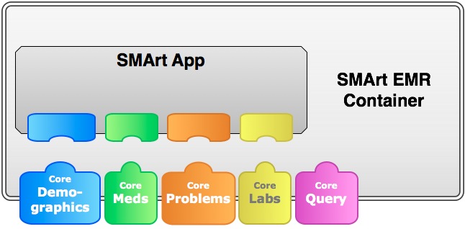
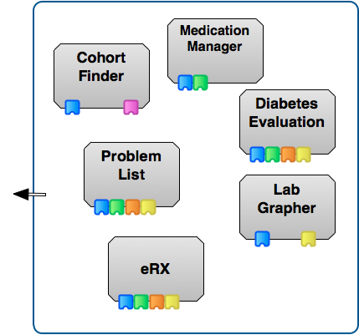
SMArt’s Technical Architecture
One SMArt Container per EMR platform enables all SMArt Applications to run in that EMR

Slide 16
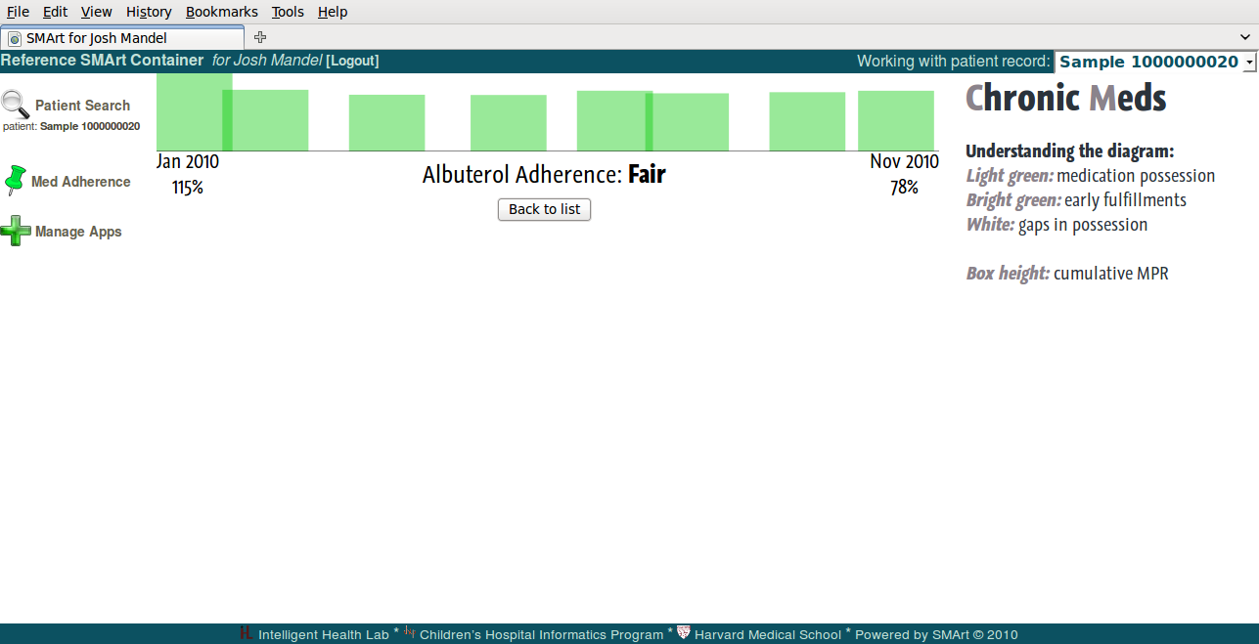
A SMArt Med Adherence App Running on the SMArt Reference Platform…
Notes:
CareWeb: the first SMArt-enabled EMR!!

Slide 17
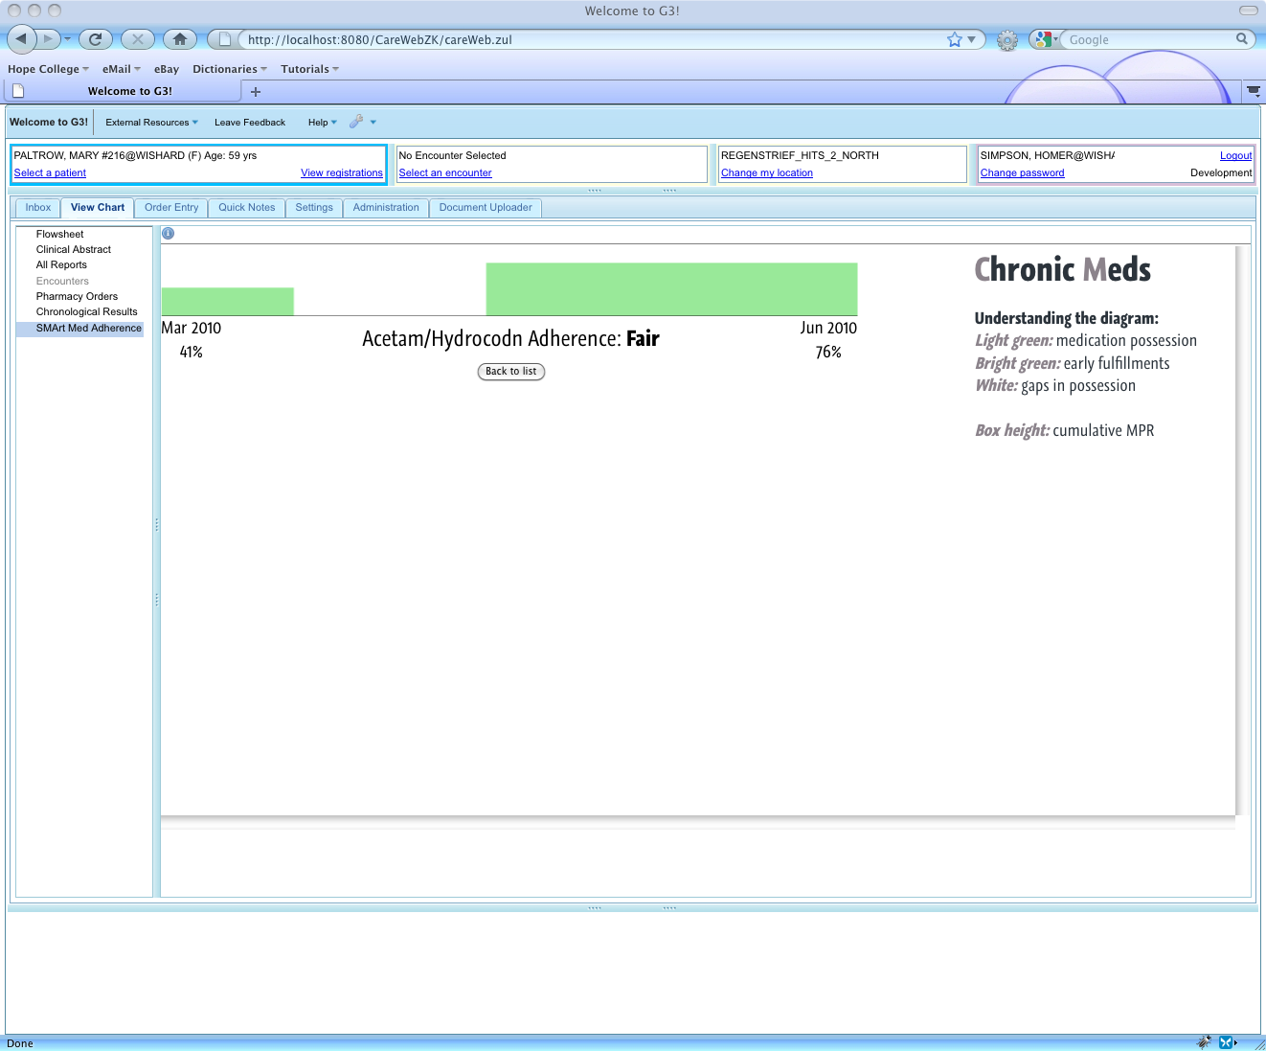
The Exact Same SMArt App Code Running in a SMArt Container on CareWeb
Notes:
CareWeb: the first SMArt-enabled EMR!!

Slide 18
G3
Super plug-in, designed to integrate physician documentation and order entry
Replacement for the venerable and well-studied Gopher CPOE
Challenge to move from a highly efficient but idiosyncratic DOS-based system to Web UI
Goal is learnability for novices and efficiency for experienced users
Uses existing metaphors

Slide 19
CDS in G3
Aiming to apply lessons from the literature on problems with clinical alerts
Goal is to reduce alert fatigue by
heeding HCI principles in alert design
focusing on “relevance” rather than severity
dynamically adjusting alerts based on context

Slide 20
Contextual CDS
Alert Triggered
Patient
Context
Physician
Context
Institutional
Context
Alert Display

Slide 21
Dynamic Adjustment of Alert Relevance
Alert Hub
…..
DDI
Alert Service
Allergy
Alert Service
Contraindication
Alert Service
DDI – Risk of Bleeding
Severity: Moderate
DDI – Risk of Bleeding
INR 3.4*, Hct 39.4
Relevance: 7 (High)
Data
Repository
Concept Relationship
INR 3.4*, Hct 39.4
INR, Hct
Bleeding | INR | HasRelevantLab
Bleeding | Hct | HasRelevantLab

Slide 22
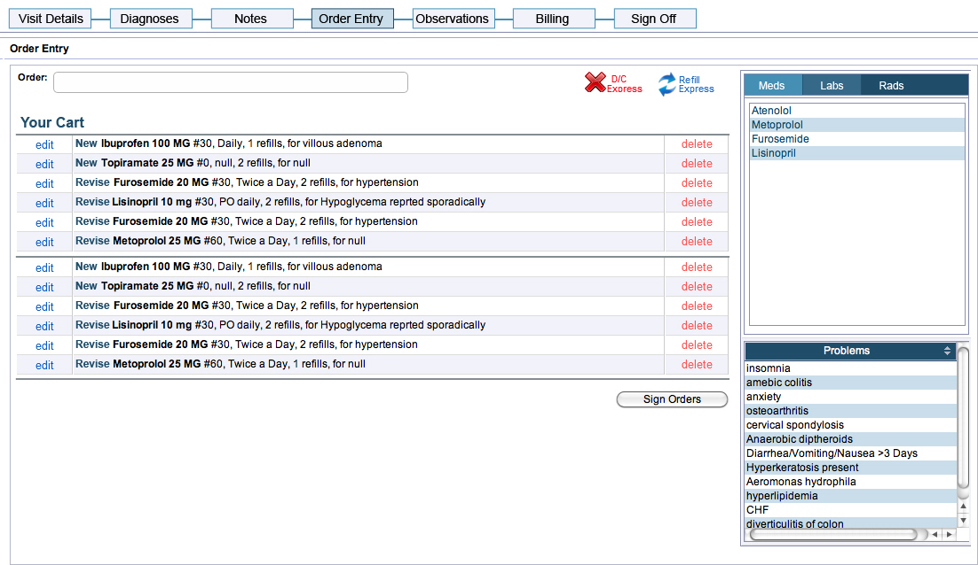

Interaction WARNING!
Support
Risk of BLEEDING
Azithromycin interacts with Warfarin
details »
Patient on Warfarin 5mg daily (last rx 8-14-10)
details »
Relevant Data
Management
INR 3.4 H 10-12-2010
Cancel Azithromycin
HCT 39.4 10-12-2010
- or -
PLT 212 10-12-2010
Discontinue Warfarin
more »
No thanks, continue this order
Helpful alert?
Yes No

Slide 23
External Plug-Ins
Developers use a variety of tools
The new framework supports flexible integration of a wide range of applications

Slide 24
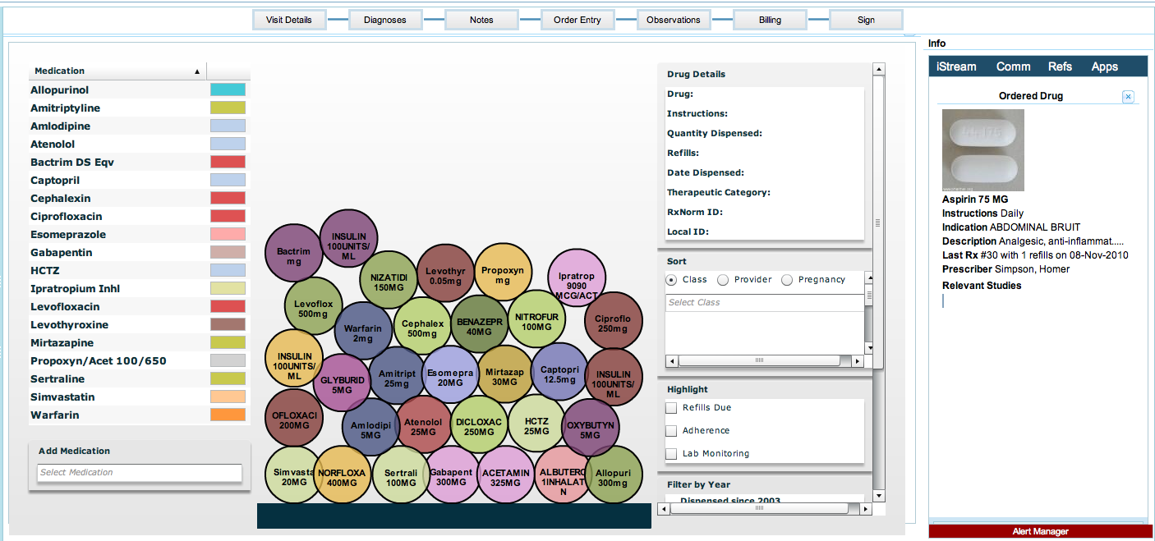
External Plug-Ins

Slide 25
Challenges
Speed, speed, speed
Scalability
Cross browser support
UI richness
UI consistency
Session interference
Dependency management
Versioning
Workflow support
Notes:
Speed, speed, speed (translated into our new platform)
Web-based application wins/challenges
Components wins/losses
SOA wins/losses
What would we do differently if we started over
Compare to our goals – did we achieve them?

Slide 26

Regenstrief Reloaded
Q & A

